Slide 1
HLSC3P96 Collector for ArcGIS
Sharon Janzen, MDGL

Slide 2
ArcGIS Online
Go to arcgis.com/home/signin.html
Sign in using the credentials sent to you
On your mobile device, download Collector for ArcGIS
You will be prompted to sign in using your ArcGIS Online credentials
Collector Tutorial and PowerPoint https://github.com/brockmdgl/BIOL4p05

Slide 3
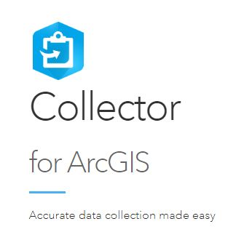
What is Collector for ArcGIS?
This mobile app is ideal for collecting data in the field then seamlessly integrate collected data to ArcGIS mapping software.

Slide 4
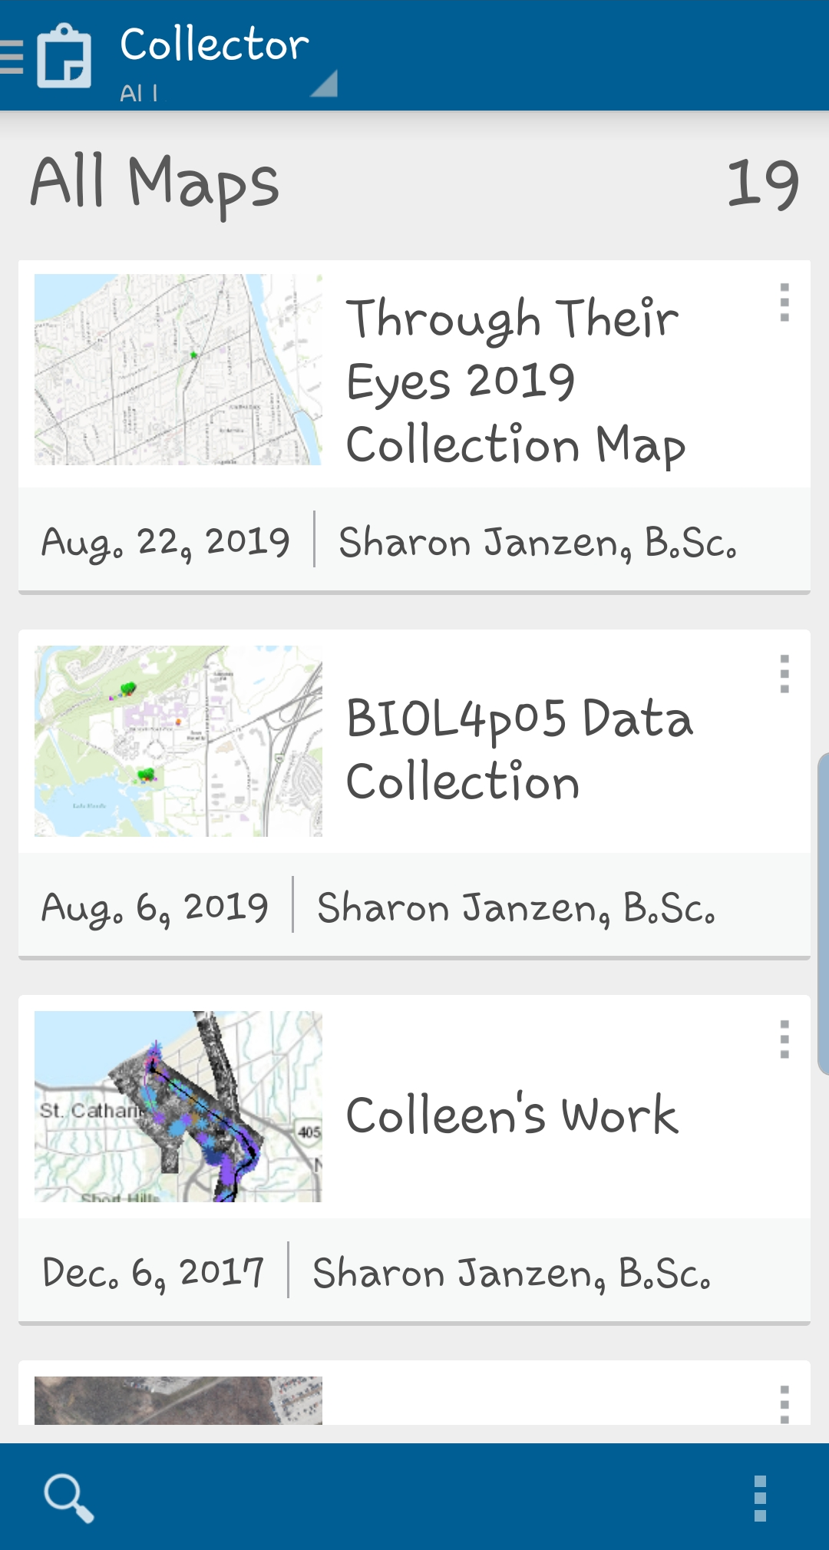

Slide 5
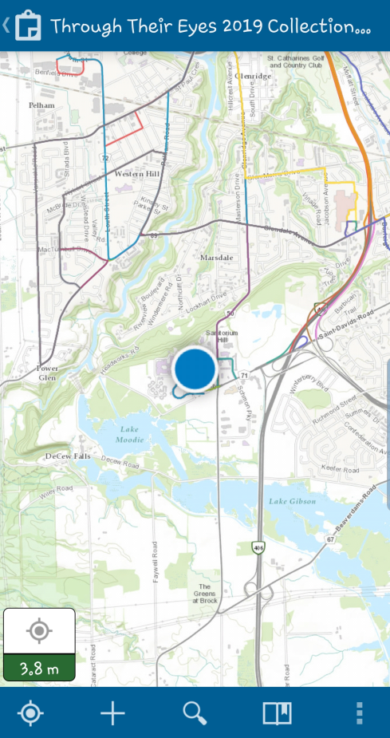
Custom Map
GPS location

Slide 6
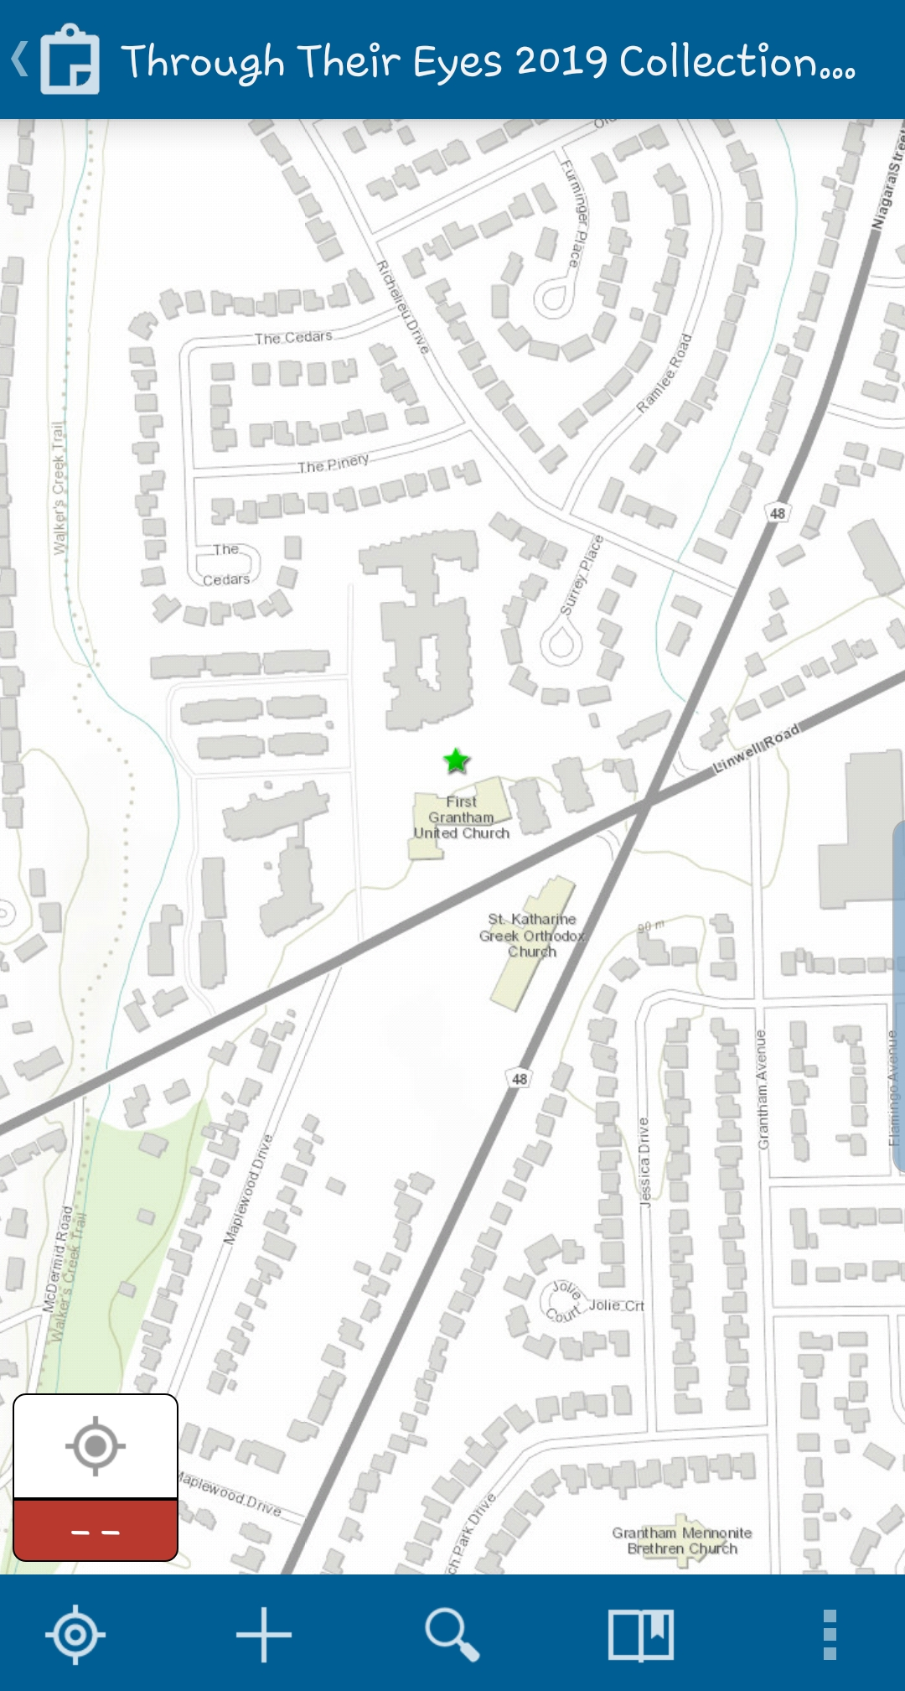
Zoom in/out by pinching
To add a feature,
Tap +

Slide 7
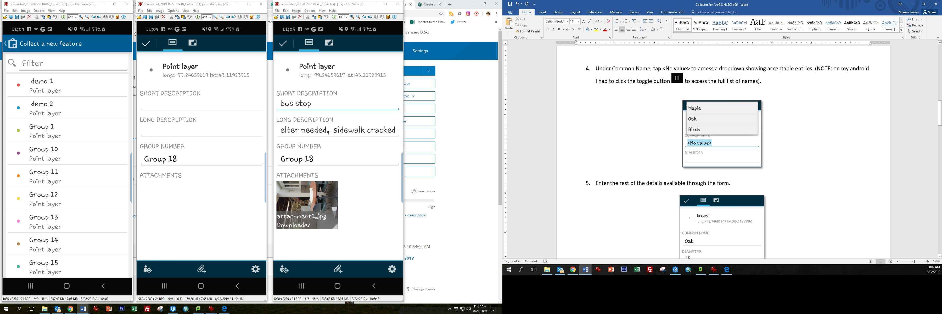
Select group number

Slide 8
Enter values
To capture a photo,
Click paperclip

Slide 9
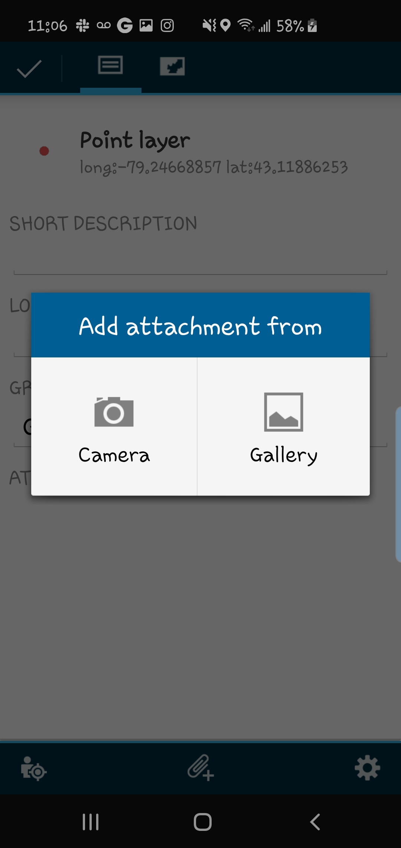
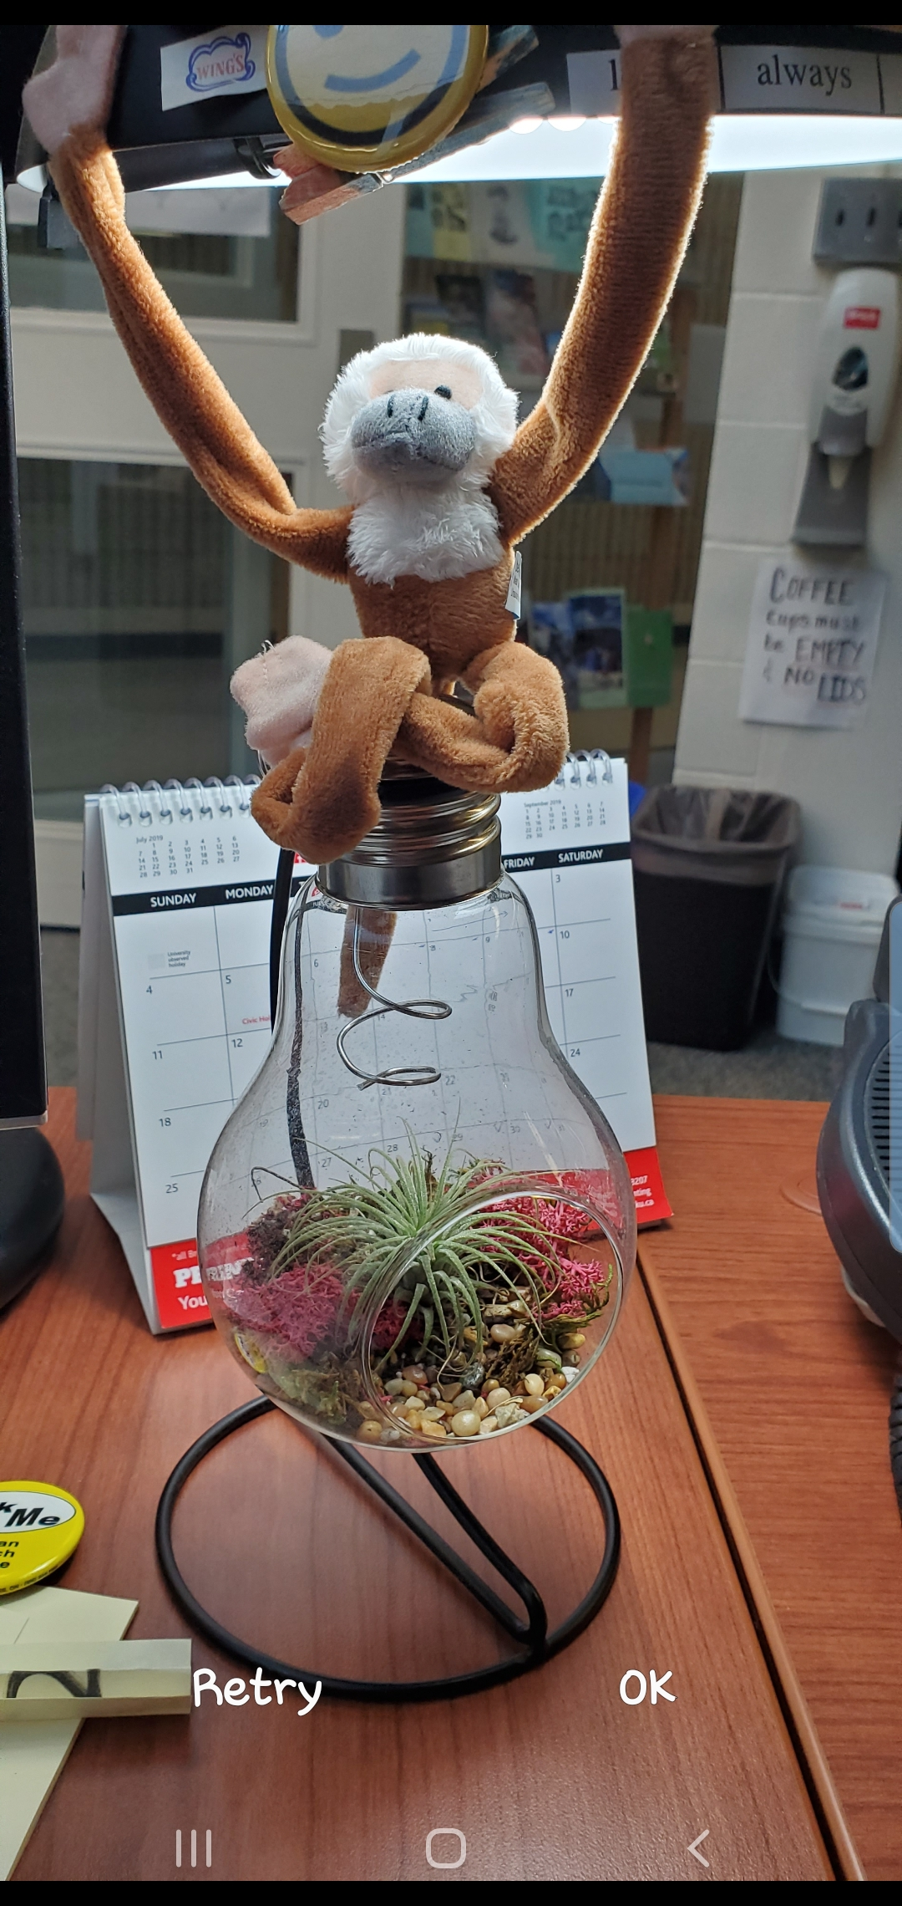
Tap Camera
Snap Photo,
Tap OK

Slide 10
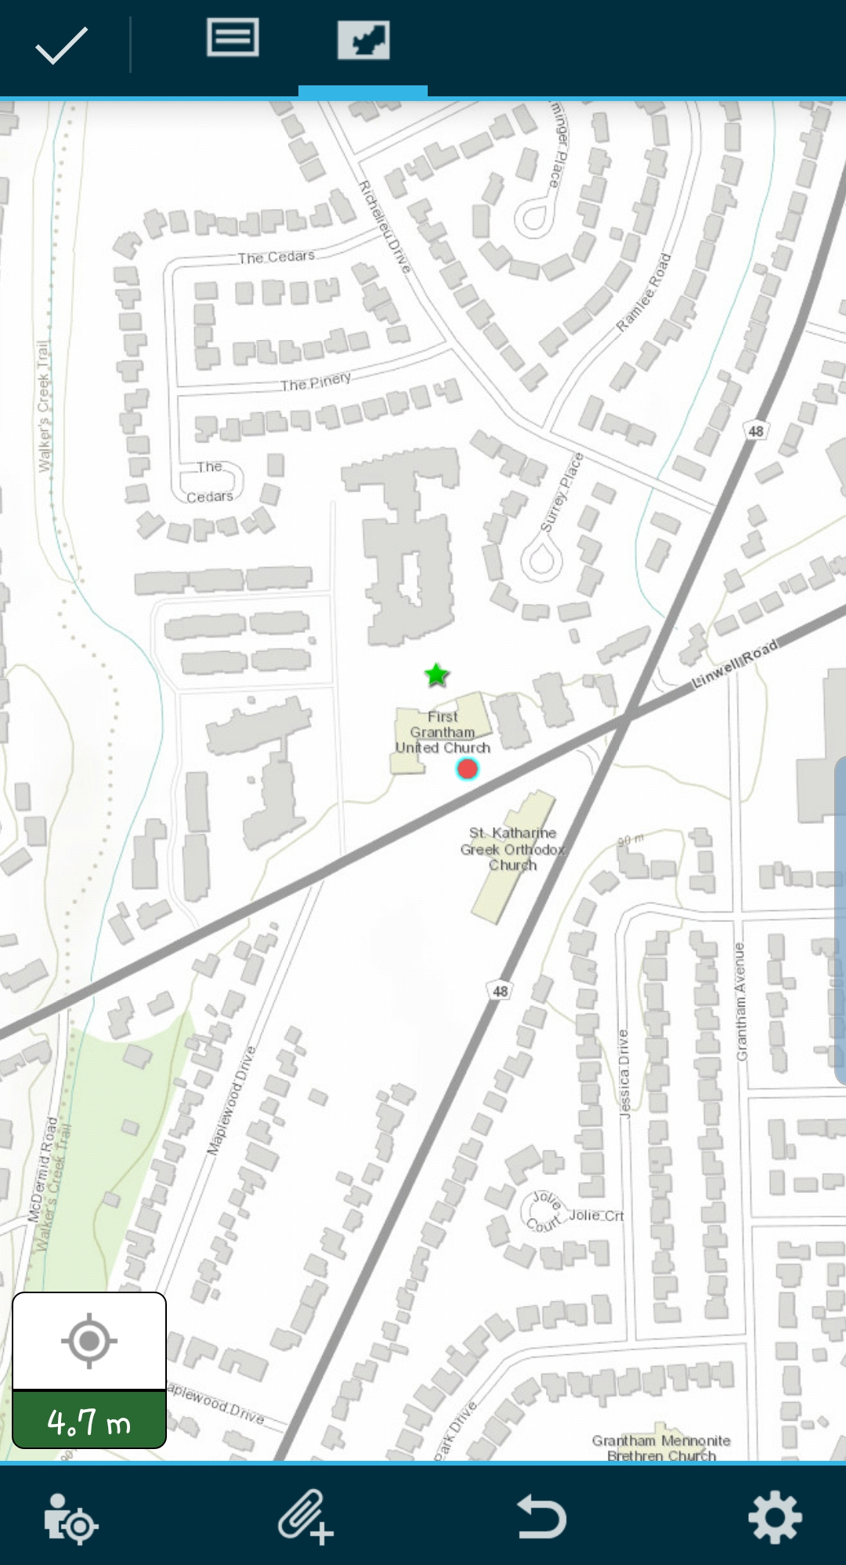
1. Tap map icon then
Zoom/pan or use GPS location
and tap to plot the point
2. Tap checkmark to finish

Slide 11
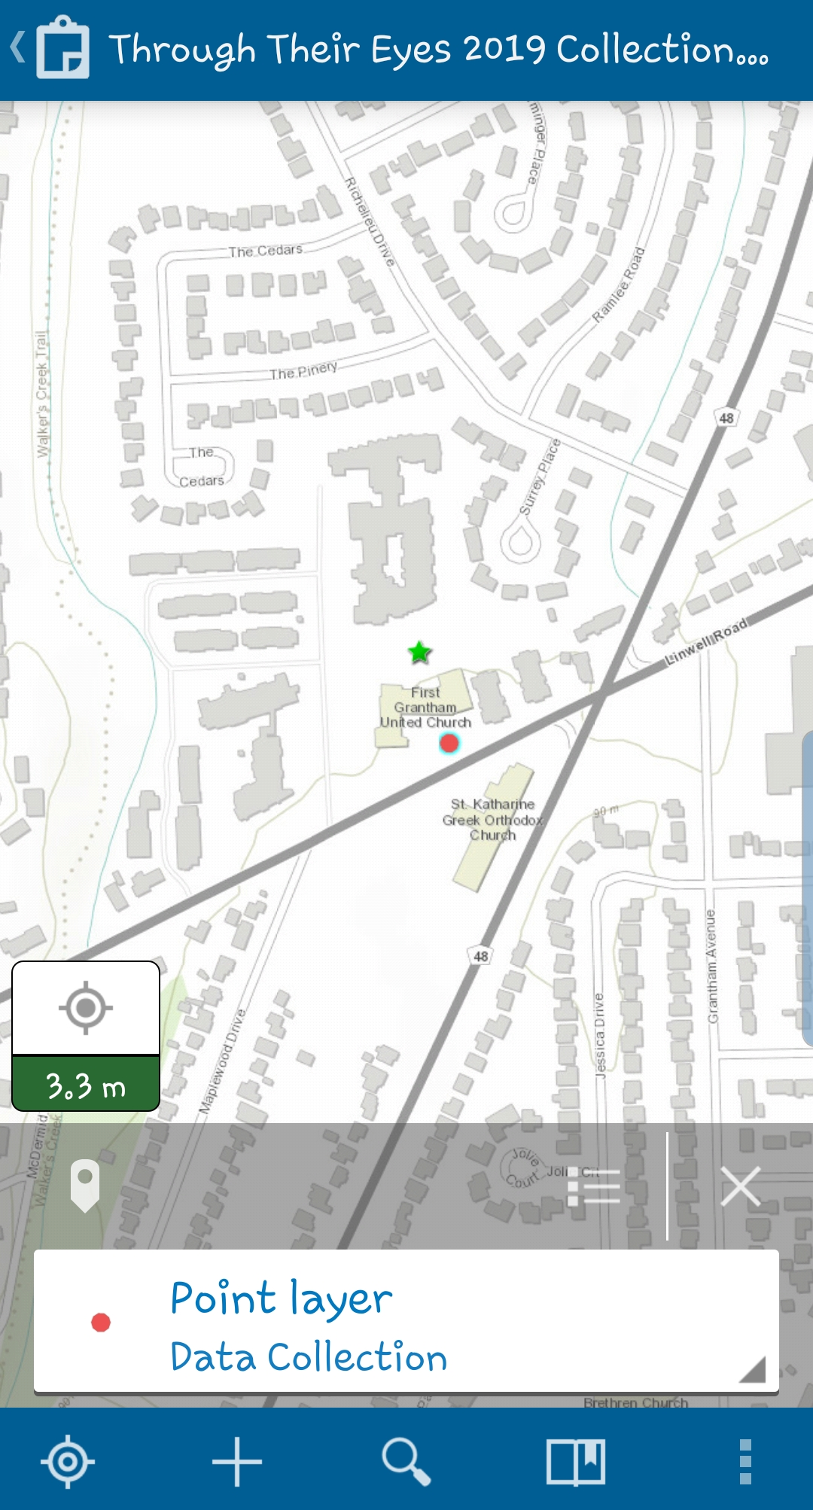
Tap here to see list of features
Tap here to edit/delete feature

Slide 12
Additional Reference Help
https://doc.arcgis.com/en/collector/iphone/help/quick-reference.htm
https://doc.arcgis.com/en/collector-classic/android/collect-data/quick-reference.htm
OR Google “Collector for ArcGIS quick reference”

